Slide 1
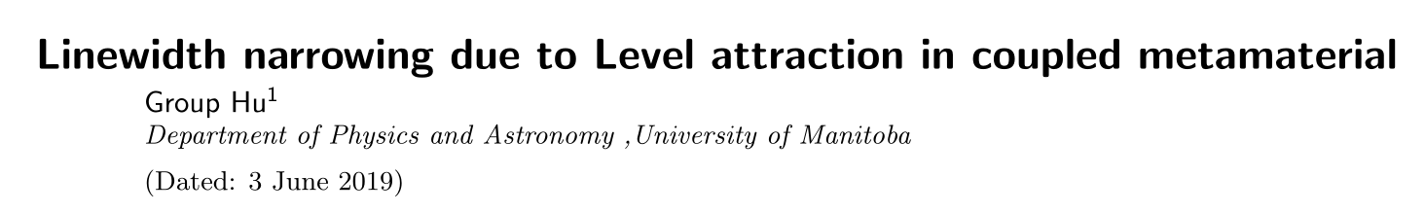
Yutong Zhao
Jun 3rd 2019

Slide 2
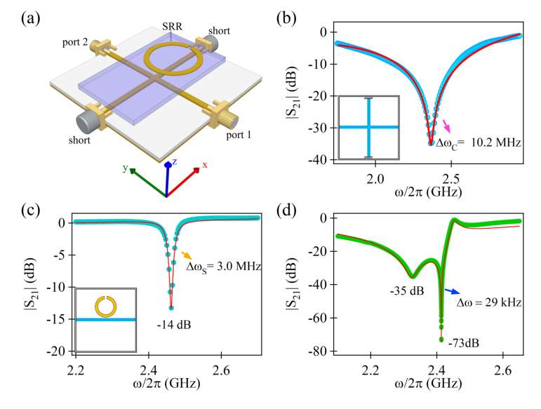
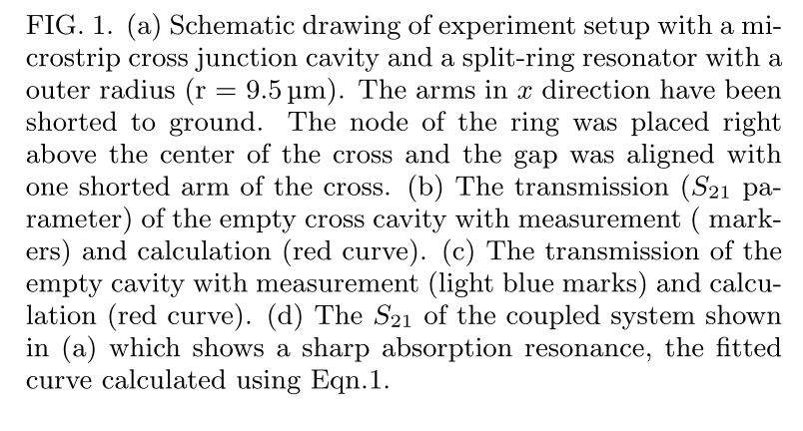

Slide 3
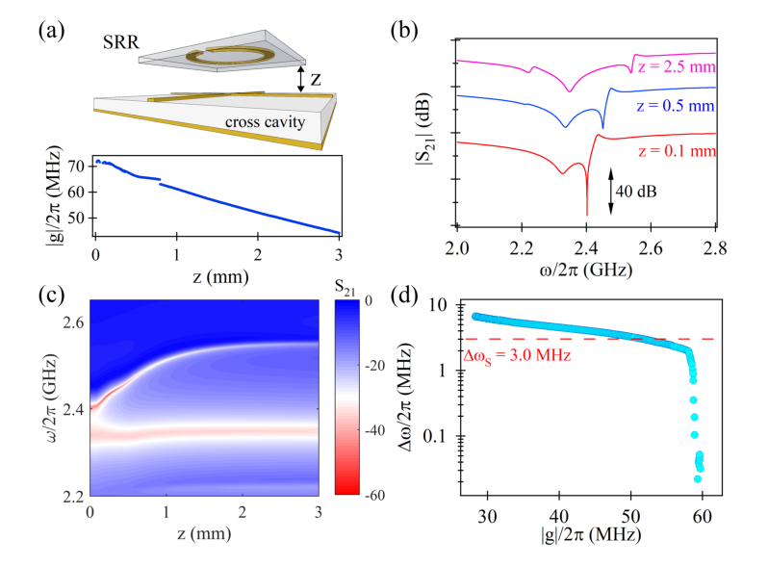
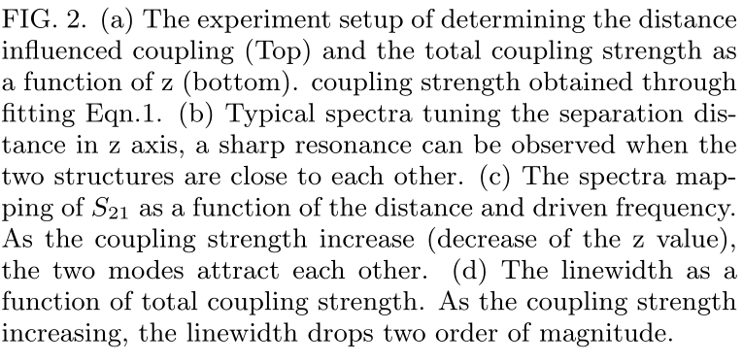
(a)(d) will be modified

Slide 4
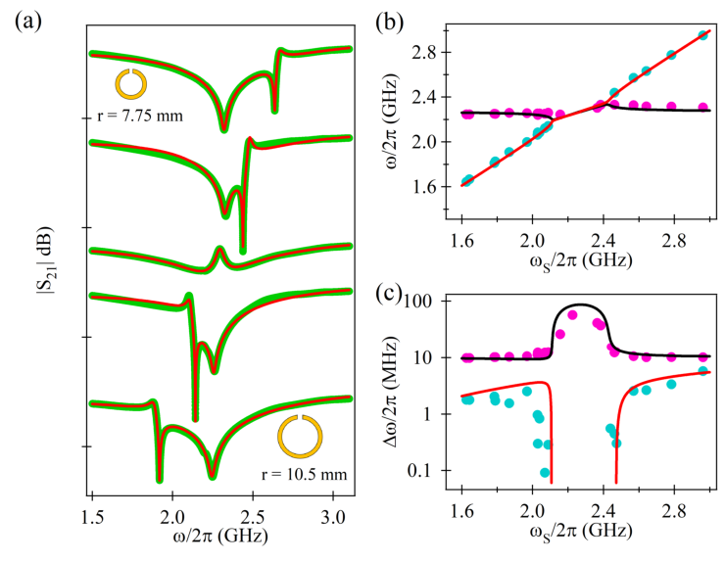
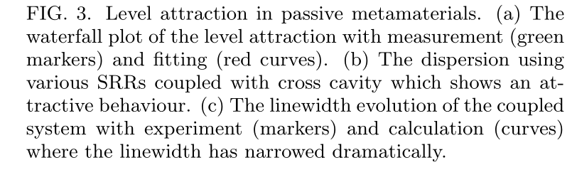

Slide 5
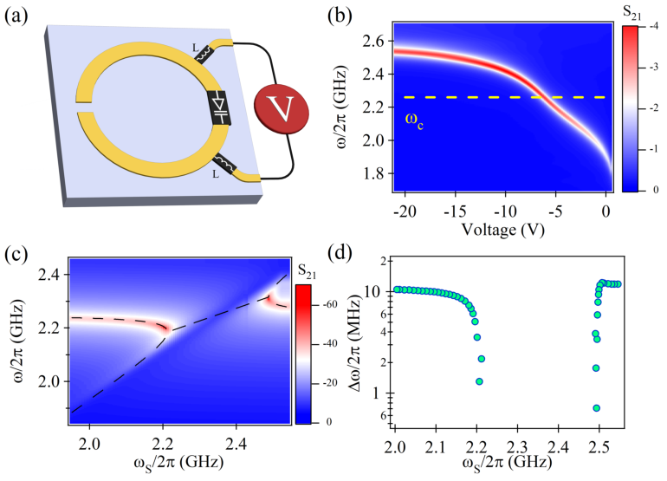
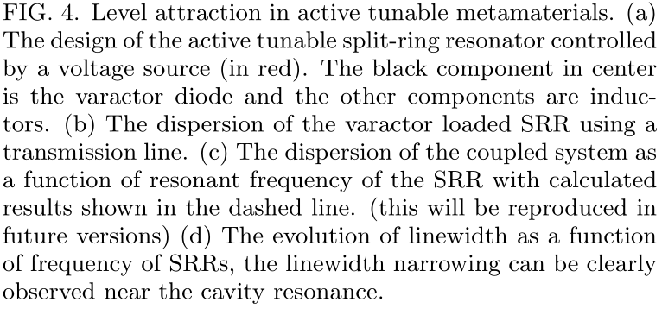

Slide 6
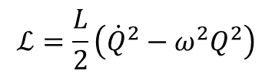
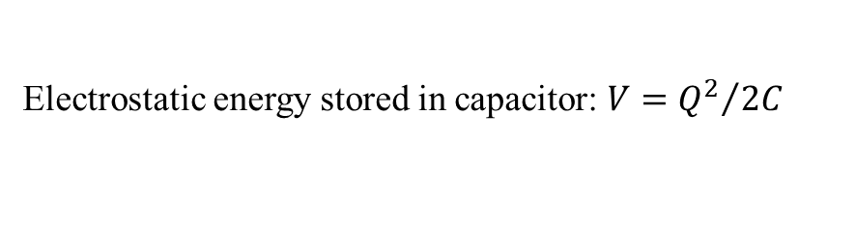

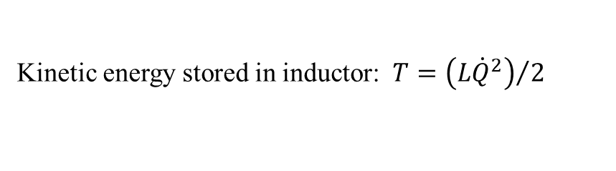
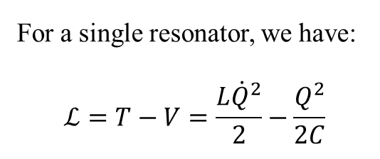
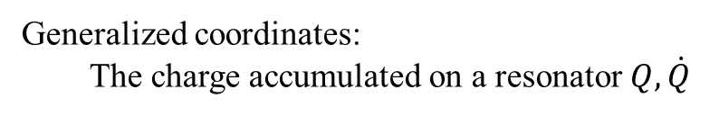

Lagrangian model (1)
Generalized coordinates:
The charge accumulated on a resonator $Q, \dot{Q}$
Kinetic energy stored in inductor: $T={\left(L{\dot{Q}}^{2}\right)}/2$
Electrostatic energy stored in capacitor: $V={Q^{2}}/{2C}$
For a single resonator, we have:
$$ℒ=T−V=\frac{L{\dot{Q}}^{2}}{2}−\frac{Q^{2}}{2C}$$
$$ω=\sqrt{LC}$$
$$ℒ=\frac{L}{2}\left({\dot{Q}}^{2}−ω^{2}Q^{2}\right)$$
Consider the coupling between two resonators, the Lagrangian is
$$ℒ=\frac{L_{1}}{2}\left({\dot{Q}}_{1}^{2}−ω_{1}^{2}Q_{1}^{2}\right)+\frac{L_{2}}{2}\left({\dot{Q}}_{2}^{2}−ω^{2}Q_{2}^{2}\right)+M_{H}{\dot{Q}}_{1}{\dot{Q}}_{2}+M_{E}ω_{1}ω_{2}Q_{1}Q_{2}$$
Rayleigh’s Dissipation function:
Mutual inductance
Mutual capacitance
$$ℱ=\frac{γ_{1}}{2}\dot{Q_{1}^{2}}+\frac{γ_{2}}{2}{\dot{Q}}_{2}^{2}+M_{R}\dot{Q_{1}}\dot{Q_{2}}$$
Mutual resistance

Slide 7
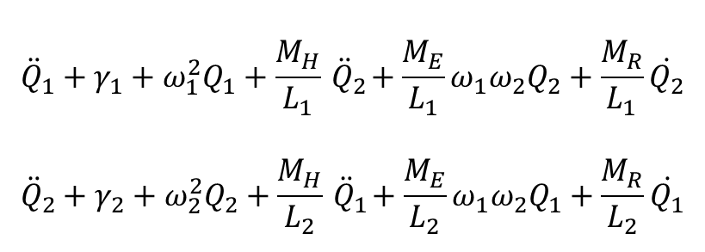

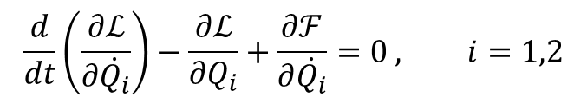

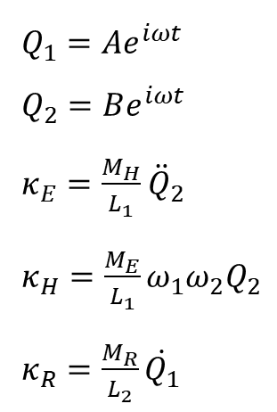
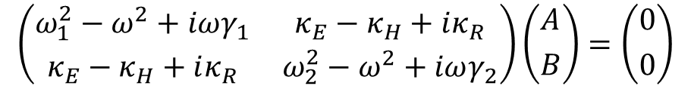
Lagrangian model (2)
Generalized Euler-Lagrange equation:
$$\frac{d}{dt}\left(\frac{∂ℒ}{∂\dot{Q_{i}}}\right)−\frac{∂ℒ}{∂Q_{i}}+\frac{∂ℱ}{∂\dot{Q_{i}}}=0 , i=1,2$$
$Q_{1}=Ae^{iωt}$
$Q_{2}=Be^{iωt}$
$κ_{E}=\frac{M_{H}}{L_{1}}{ \ddot{Q}}_{2}$
$κ_{H}=\frac{M_{E}}{L_{1}}ω_{1}ω_{2}Q_{2}$
$κ_{R}=\frac{M_{R}}{L_{2}}\dot{Q_{1}}$
$${\ddot{Q}}_{1}+γ_{1}+ω_{1}^{2}Q_{1}+\frac{M_{H}}{L_{1}}{ \ddot{Q}}_{2}+\frac{M_{E}}{L_{1}}ω_{1}ω_{2}Q_{2}+\frac{M_{R}}{L_{1}}\dot{Q_{2}}$$
$${\ddot{Q}}_{2}+γ_{2}+ω_{2}^{2}Q_{2}+\frac{M_{H}}{L_{2}}{ \ddot{Q}}_{1}+\frac{M_{E}}{L_{2}}ω_{1}ω_{2}Q_{1}+\frac{M_{R}}{L_{2}}\dot{Q_{1}}$$
$$\left(\begin{matrix}ω_{1}^{2}−ω^{2}+iωγ_{1} & κ_{E}−κ_{H}+iκ_{R} \\ κ_{E}−κ_{H}+iκ_{R} & ω_{2}^{2}−ω^{2}+iωγ_{2}\end{matrix}\right)\left({A \atop B}\right)=\left({0 \atop 0}\right)$$
$$g=J+iΓ$$
$J=$ $κ_{E}−κ_{H}$, $Γ=κ_{R}$

Slide 8
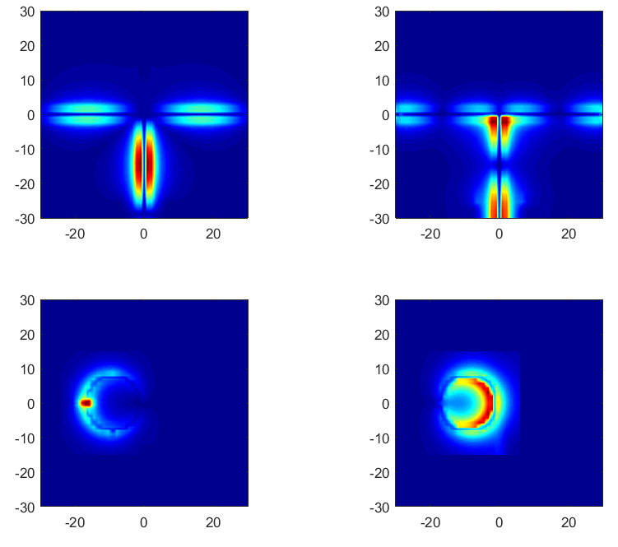
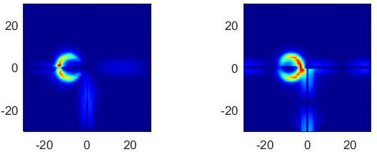
Cross E
Cross H
SRR E
SRR H
Coupled E
Coupled H

Slide 9
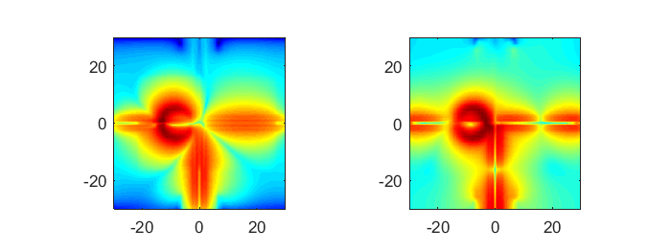
Coupled E dB scale
Coupled H dB scale

